Slide 1


Session 2
Python Syntax - 1
Data types

Slide 2
Learning Outcomes
Python data types
Basic data types (int, float, and bool)
type() function
Strings
Type casting
Lists
String and list indexing
Indexing and Slicing

Slide 3
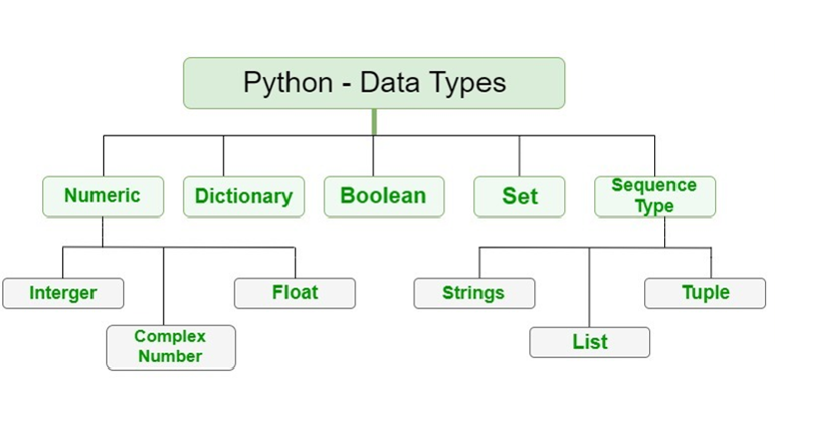
1) Python data types

Slide 4
Basic data types (int, float, and bool)
a = 10
In the above cell, we are assigning the integer value to the variable a. So the datatype of variable a is int The variable name can be any combination of characters as long as it follows the rules for defining variable names we discussed earlier. Usually, when we define a variable we name it depending on the value that it is going to hold. This helps us recognize and remember the variable name later in the code.
my_varibale = 20
no_of_lines = 4
Since Python is dynamically typed, the variable data type is determined by the value we assign to it on the right-hand side of the assignment operator (=)
my_float = 12.12
In the above line, the variable my_float is of the type float since we are assigning it a decimal point number
my_bool = True bool_2 = False
When we assign the value of True or False to the variable my_bool or bool_2 they are considered as bool datatype by Python.
The T and F in True and False should be capital

Slide 5
2) type() function
The type function is used to check the datatype of the variable declared.
This function will show the keyword used by the python for that particular data type
the type() function returns a string which should be printed out to see the output
a = 500 print(type(a))
<class 'int'>
a = True print(type(a))
<class 'bool'>
mystring = "hello world" print(mystring) print(type(mystring))
hello world <class 'str'>
b = 500.12 print(type(b))
<class 'float'>

Slide 6
3) String datatype
A string is a collection of characters In other languages we have a separate data type called char which stores individual characters In Python we can get the same behavior by defining a string of length 1.
In Python, a string can be defined by enclosing the characters in single double or triple quotes
my_string1 = 'hello world'
my_string2 = "hello world"
my_string3 = ''' hello world'''
The intention behind providing this kind of flexibility is considering the cases where we will have to have an actual single or double quote in our sentence Suppose we want to print the following line This is Sam's house
my_string1 = 'This is Sam's house'
File "<ipython-input-11-6f004d05cb8a>", line 1 my_string1 = 'This is Sam's house' ^ SyntaxError: invalid syntax

Slide 7
4) Type Casting
Type casting is the process of converting one datatype to another datatype.
Let's try to build an application that takes input from the user and returns the number entered + 10
a = input("enter the number : ") print(a+10)
enter the number: 20
TypeError Traceback (most recent call last) <ipython-input-8-f16ddfb0e55c> in <module> 1 a = input("enter the number : ") ----> 2 print(a+10) TypeError: can only concatenate str (not "int") to strr value 10 to the variable 'a'
a = input("enter the number : ") a_int = int(a) print(a_int+10)
enter the number: 20 30

Slide 8
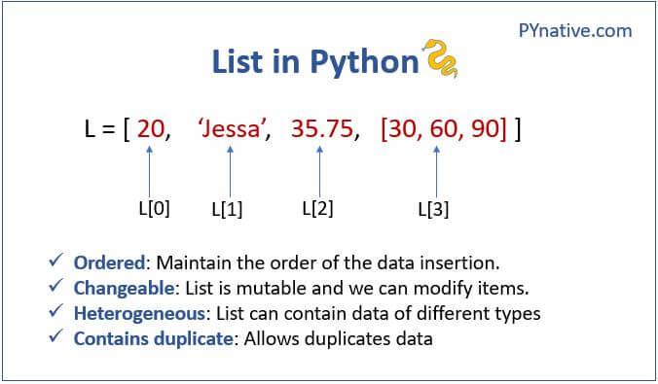
4) Lists

Slide 9
Lists are constructed with brackets [ ] and commas separating every element in the list.
# Assign a list to a variable named my_list my_list = [1,2,3] print(my_list)
[1, 2, 3]
We just created a list of integers, but lists can hold different object types. For example:
my_list = ['A string',23,100.232,'o'] print(my_list)
['A string', 23, 100.232, 'o']
Lists can hold any object in Python. Including another list. Such a list can also be called a multi-dimensional list
my_list = [[1,2,3],[4,5,6],[7,8,9]] print(my_list)
[[1, 2, 3], [4, 5, 6], [7, 8, 9]]

Slide 10
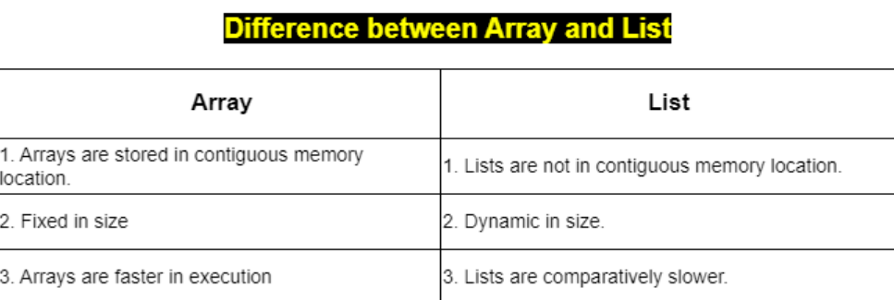
Difference between list and array

Slide 11
6) Indexing and Slicing
Indexing refers to accessing individual elements on a collection data type
Slicing refers to accessing a group of elements from the collection data type
Indexing
my_list = [11,22,33,44,55,66] my_list[3] Output : 44
The Index number of elements starts from 0
list elements: 11 22 33 44 55 66 index numbers : 0 1 2 3 4 5
The Indexing can also be applied to a string
x = "hello" x[4] Output : 'o'
The examples we saw were of single-dimensional indexing. We can also do indexing on multi-dimensional objects to access elements
my_list = [[1,2,3],[4,5,6],[7,8,9]] my_list[1] Output: [4, 5, 6]

Slide 12
Indexing continued
we can use negative indexing to get the elements from the last of a list or collection datatype
list elements: 11 22 33 44 55 66 index numbers: -6 -5 -4 -3 -2 -1
my_list = [11,22,33,44,55,66] my_list[-2]
55
Slicing
syntax
my_list[start index : stop index : step size]
my_list = [11,22,33,44,55,66,77,88,99] my_list[2:5:1]
[33, 44, 55]

Slide 13
REVISION
Python data types
Basic data types (int, float, and bool)
type() function
Strings
Type casting
Lists
String and list indexing
Indexing and Slicing
HOMEWORK
Try to grab the number 400 using a list my_list = [[1,2,3],'hello',[7,8,[100,200,300,400]]]
Try to grab the word 'own' from the below string my_str = "ON my own technology"
Replace the 3rd item in the list with the string "OMOTEC" my_lst = ["welcome", "to", "on my own technology"]
create a basic calculator
Take 2 numbers from the user (using input statement)
Print out the addition and multiplication of those 2 numbers

Slide 14
HOMEWORK SOLUTION
#TASK 1 my_list = [[1,2,3],'hello',[7,8,[100,200,300,400]]]
print(my_list[2][2][3])
400
HOMEWORK SOLUTION
#TASK 2
my_str = "ON my own technology"
print(my_str[6:9])
own

Slide 15
#TASK 5 Find the position of bat list2 = ['cat', 'bat', 'mat', 'cat', 'pet']
#TASK 6.Find the position of 55 from the list using index fruits = [22,33,42,55,61]
#TASK 7 Use the step parameter to return every third item using the slice: a = ("a", "b", "c", "d", "e", "f", "g", "h")
#TASK 8 Start the slice object at position 3, and slice to position 5, and return the result: a = ("s", "e", "n", "t", "e", "n", "c", "e")

Slide 16
THANK - YOU

